Slide 1
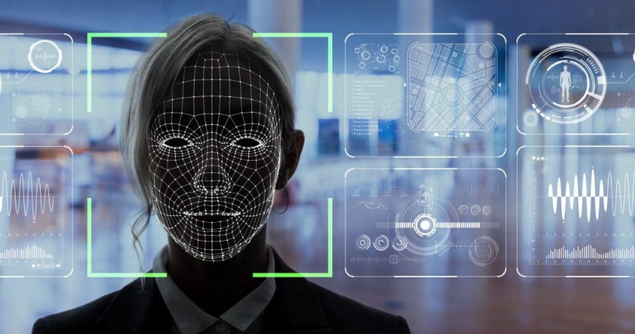
Facial Image Recognition using CRI-AI Thermal Cameras
Image Source: https://ngscinc.com/access-control-trends-for-2021-facial-recognition/

Slide 2
Content
Project Summary
Team Profile
Project Progress update
Individual Status Report
High-Level Timeline Chart (GANTT)
Plans for the next weekly status report

Slide 3
Project Summary
Purpose of this project is to develop a model a facial recognition system using CRI- AI Thermal cameras. CRI stands for Color Rendering Index and is nothing but a specification of cameras which states how accurately artificial light shows colors of the people under them.
Facial Recognition is the process of identifying a person through his or her facial features. We will be using thermal cameras to detect human faces. When we think about thermal images in the context of people, what usually comes to mind is night vision. The ability to see a person, or group of people, by the inevitable heat their bodies emit.
An important aspect of our project requires us to understand that thermal images capture heat in the form of frequency of pixels, varying from 0 to 1. Studies have found that each face emits a unique heat signature due to the blood vessels below the skin, as mentioned by Barclay (2013). Therefore, thermal facial images capture unique individual facial heat signatures which mark as unique biomarkers, providing us with rich information to classify a person correctly using a model.

Slide 4
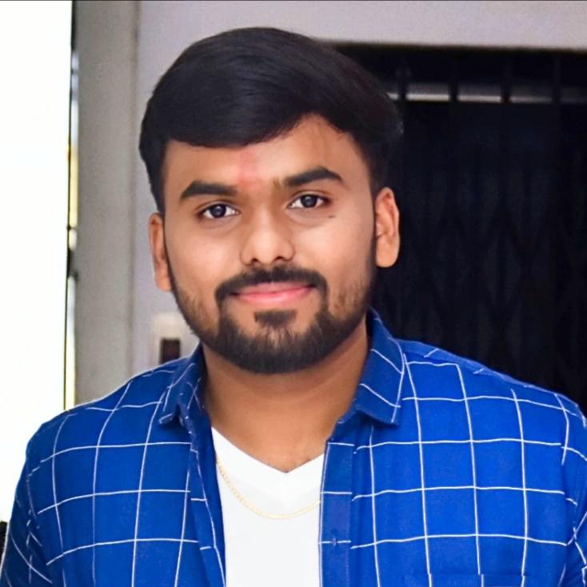


Team Profile
Kishan Patel
(B.Sc. Physics, PGDCA, Big Data Solution Architecture)
A Big Data Analyst having non-cs bachelor degree, yet significantly interested, and competent in AI industry.
Tilak Pandya
(BCA, MCA)
A developer who explores concepts and potential in the tech industry.
Namrakumar Patel
(B.E. Computer Science)
A developer with real-world problem solving experience and a desire for innovation.

Slide 5
Project Progress Update
Convert Image in Thermal and grayscale images
Store multiple images in dataset
Explore the capacity of CRI AI Cameras
Problem statement/scope of work
Update Git repository
Presentation.

Slide 6
Individual Status Report
Namra:
Identify ways to store limited multiple images in Dataset.
Explore the capacity of CRI AI Cameras
Tilak:
Convert Image to gray scale and thermal images
Presentation
Kishan:
Develop code to store limited multiple images in the dataset
Analyze Problem statement/scope of work

Slide 7
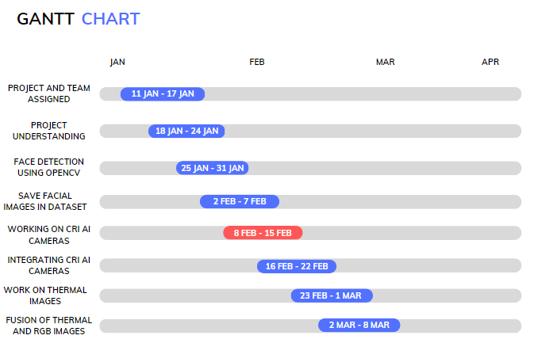
High-Level Timeline Chart (GANTT)

Slide 8
Thermal Images detection References
For more information on the cv2.cvtColor function, you can refer to the OpenCV documentation: https://docs.opencv.org/master/d9/d61/tutorial_py_morphological_ops.html
For more information on the cv2.applyColorMap function, you can refer to the OpenCV documentation: https://docs.opencv.org/master/d3/d50/group__imgproc__colormap.html
For more information on the cv2.imwrite function, you can refer to the OpenCV documentation: https://docs.opencv.org/master/d4/dc0/group__imgcodecs.html

Slide 9
Time to work on N-101:
Tuesday: all day
Wednesday: Morning
Thursday: Morning until 11 or after 12:00

Slide 10
Now Onwards …
Work upon Image Segmentation.
Start working on integration of CRI AI Cameras.
Capture and store thermal Images using CRI AI Cameras.

Slide 11
Thank you!

